Slide 1
DDoS Attacks Detection and Mitigation in SDN using Deep Learning Approaches
Submitted By: Mamdouh Muhammad
Professor: Univ.-Prof. Dr. rer. nat. J. Seitz
Advisor: M.Sc. Abdullah Soliman Alshra'a
Master Thesis Defense

Slide 2
Outline
Software-Defined Networking (SDN)
Taxonomy of SDN Vulnerabilities
Distributed Denial Of Service (DDoS) attack
Deep Learning approaches
Problem Statement
Datasets
CICDDoS2019 & Preprocessing steps
Algorithm Design
System design
Results
Conclusion and Future Work
References

Slide 3
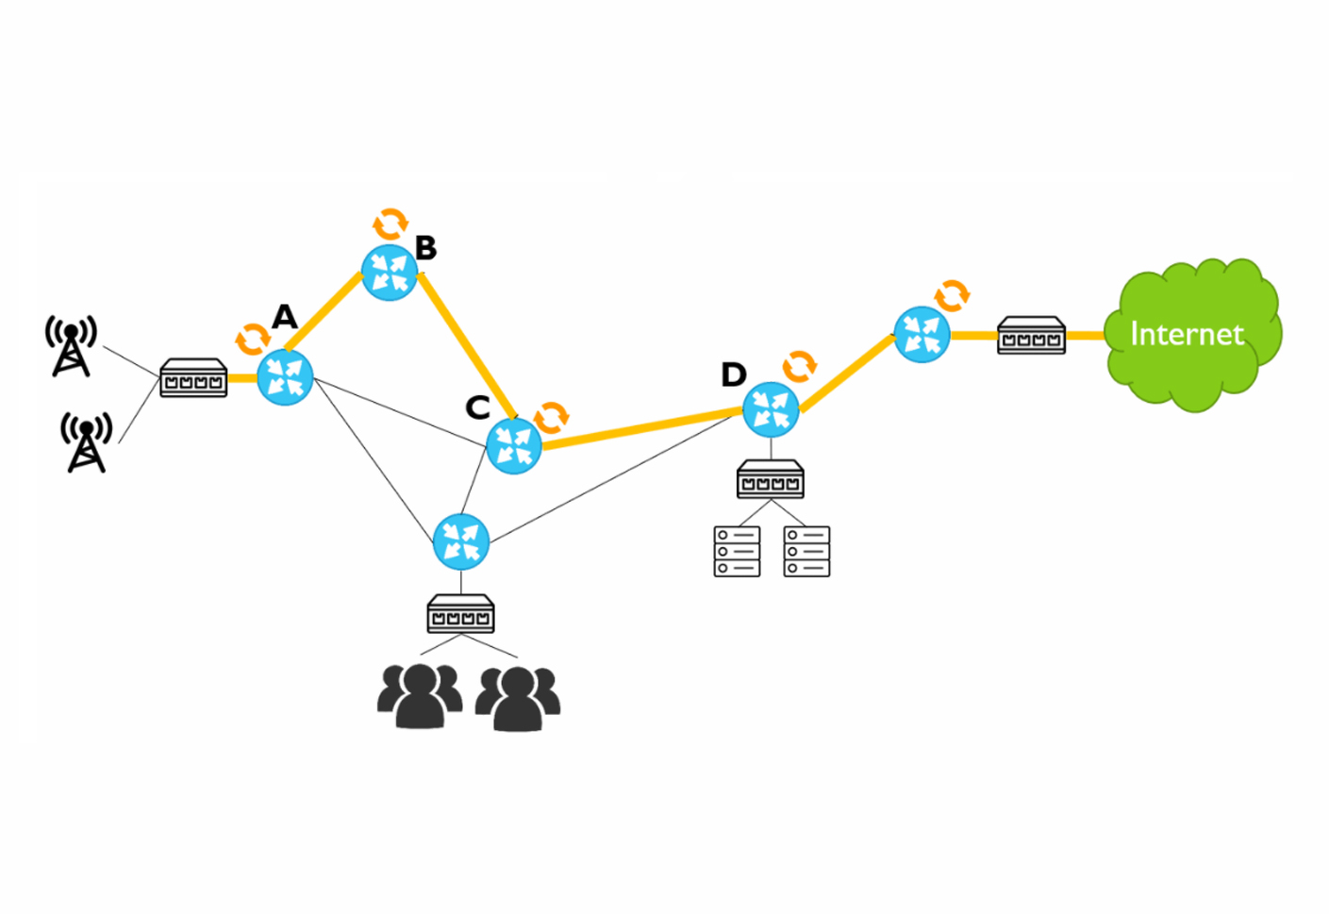
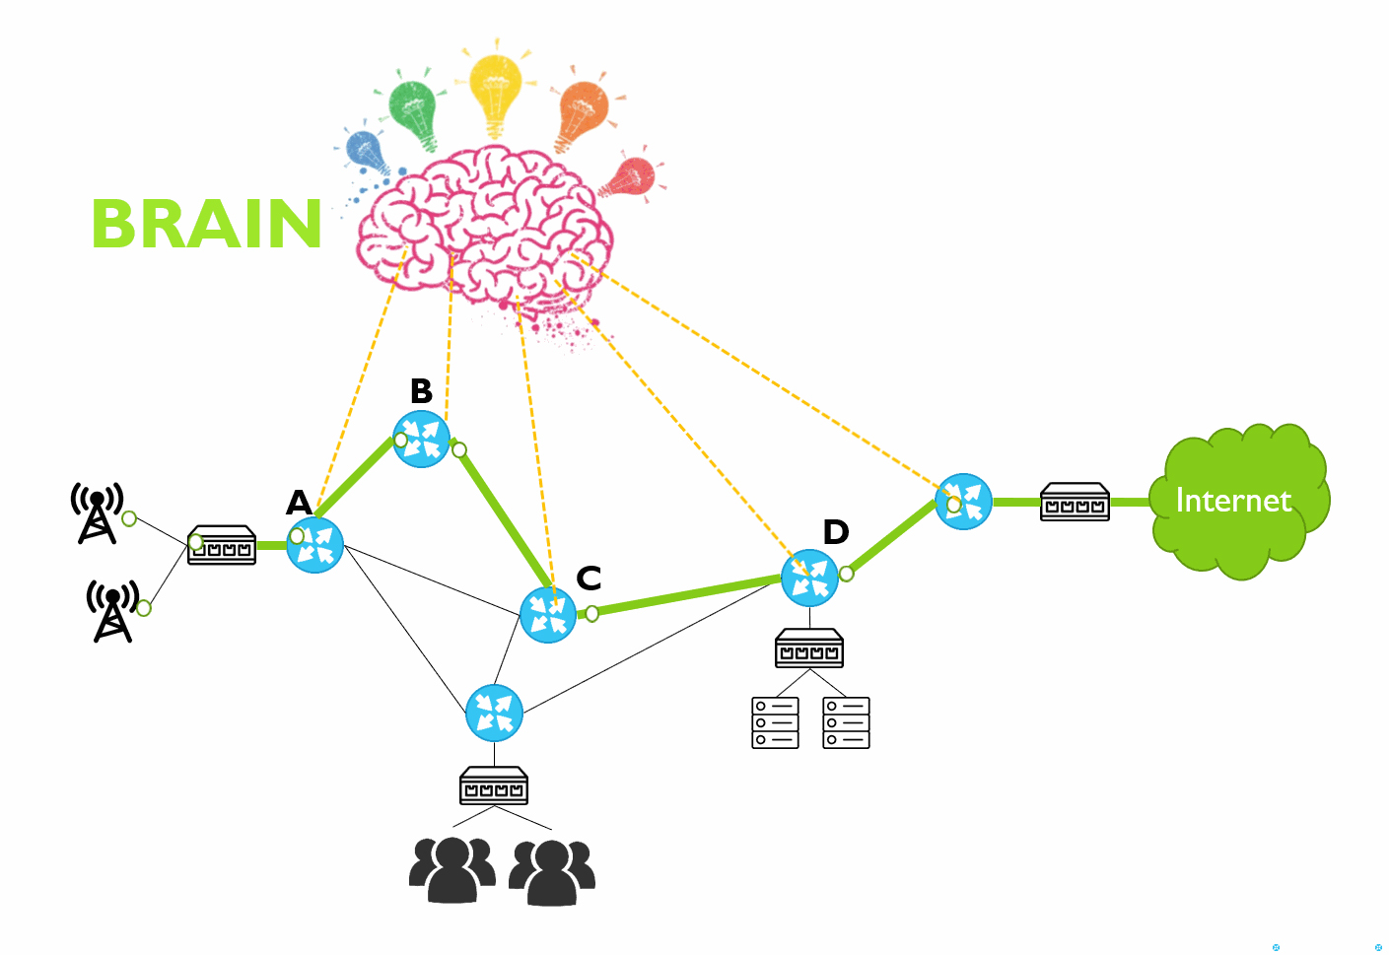

Software-Defined Networking (SDN)
What?, How?, Why?
Traditional Networks vs SDN Networks
- Management and Auto.
- Troubleshooting
- Vendor-dependency
- Attacks

Slide 4
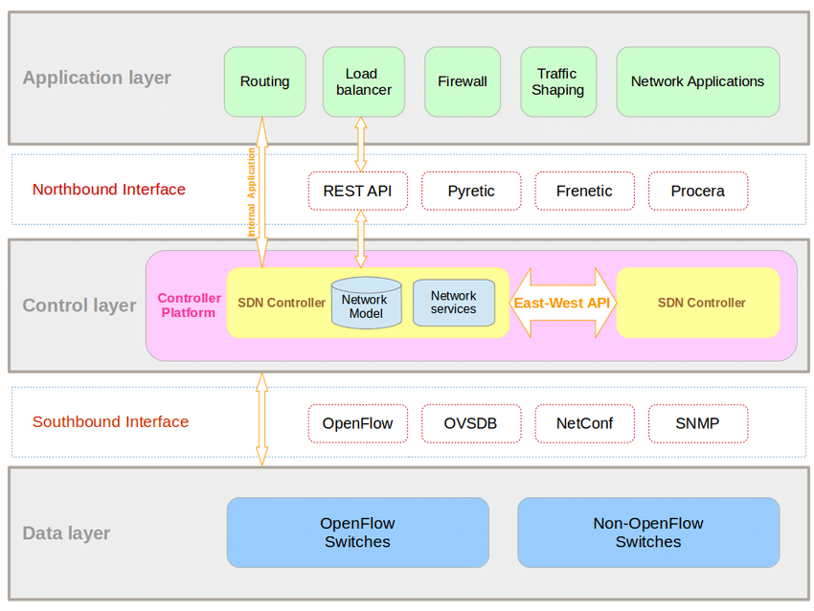
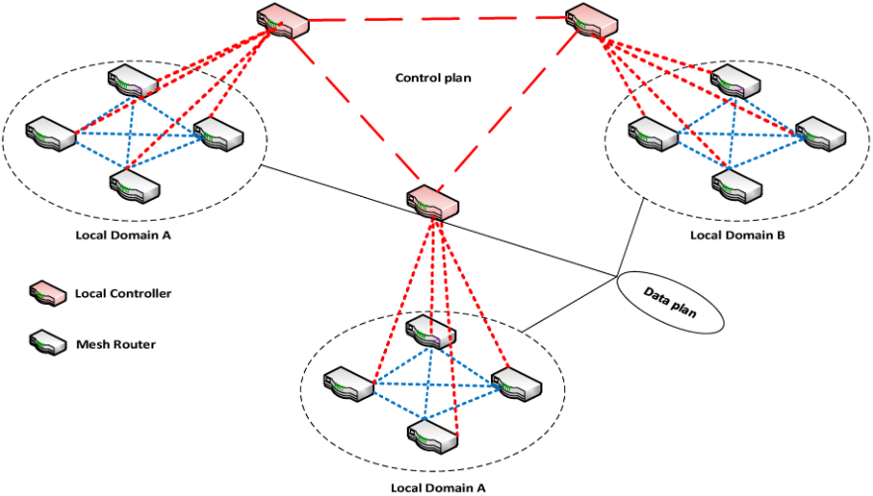
Software-Defined Networking (SDN)
SDN Layers and Distributed SDN controllers

Slide 5
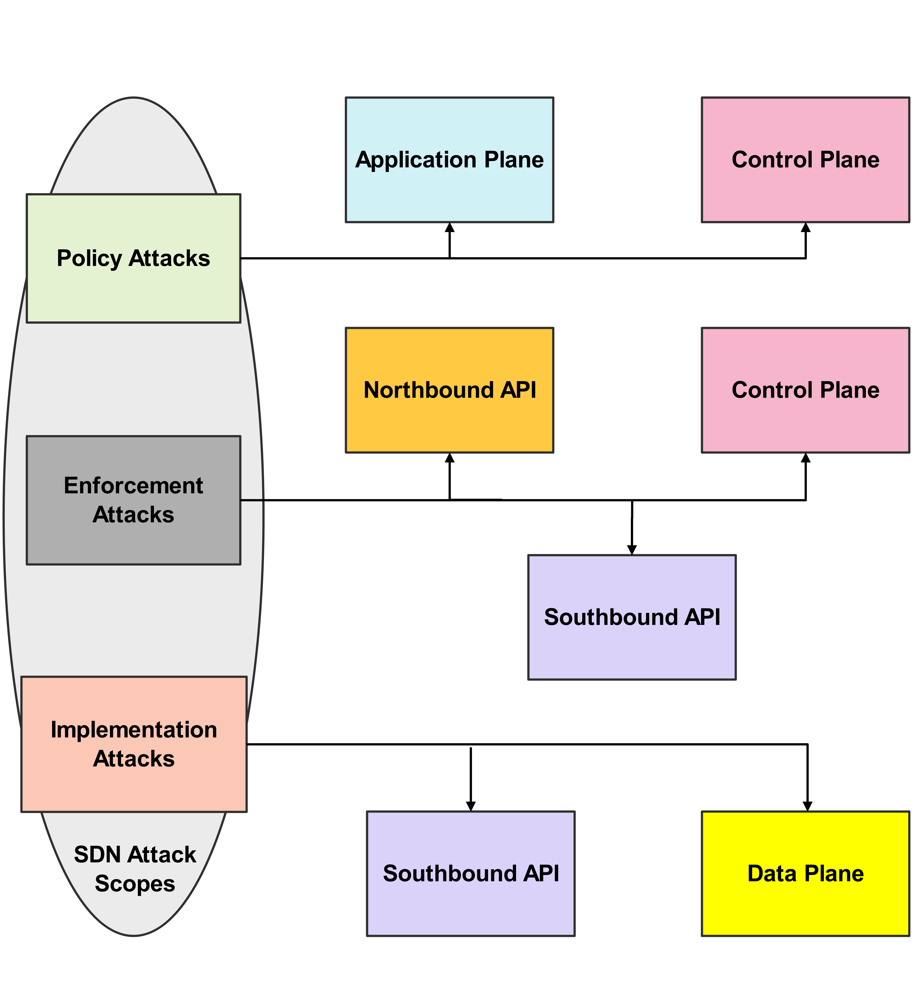
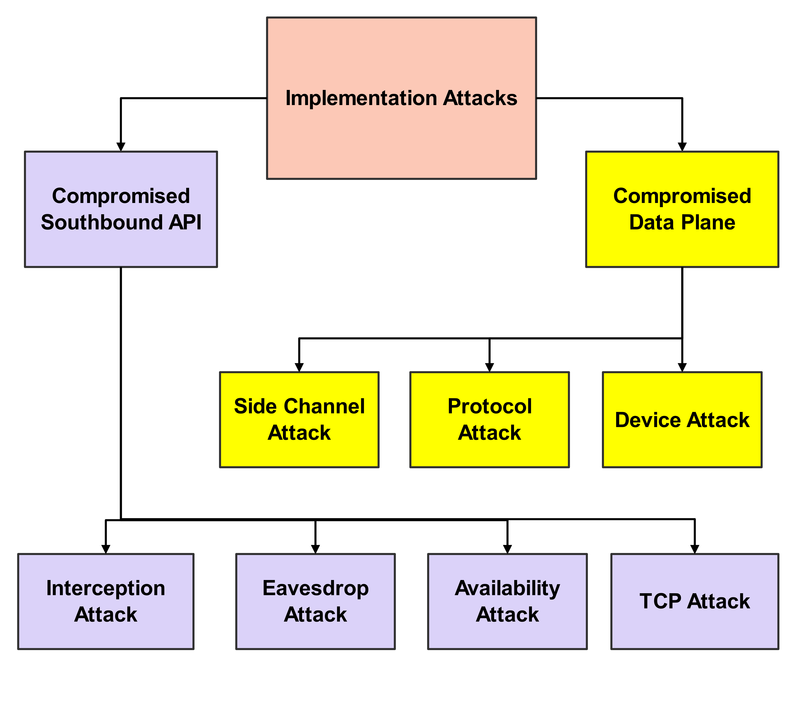
Taxonomy of sdn attacks
Notes:
Policy attacks: Application Plane
Enforcement attacks: Control Plane
Implementation attacks: Data plane

Slide 6
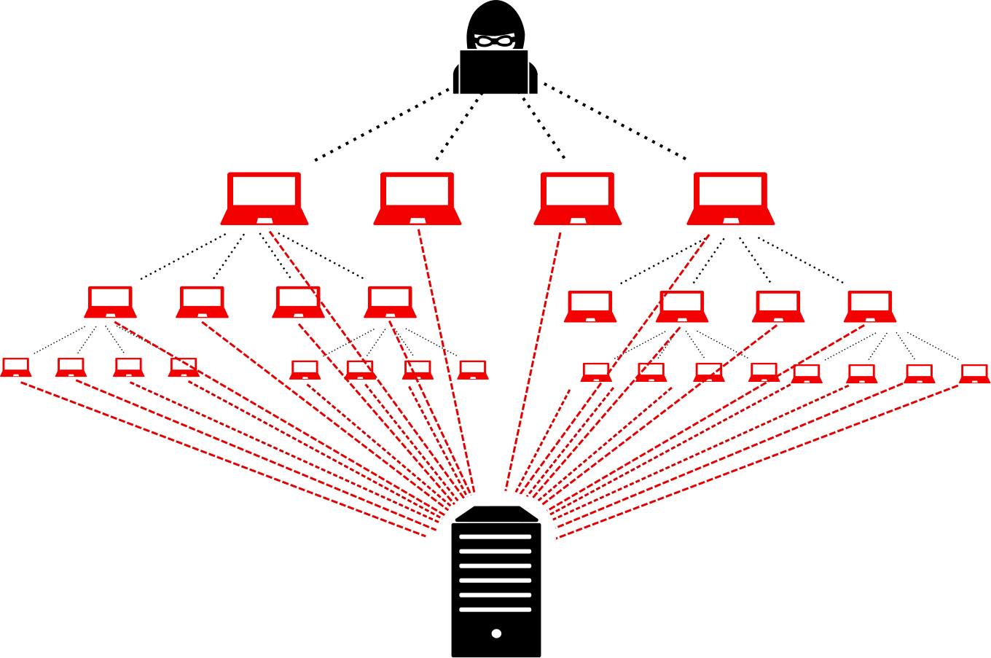
Distributed Denial-of-Service (DDoS)
Definitions and Tools
Definitions
DoS
Zombie
Botnet
Tools
GUI tools like LOIC and HOIC
CLI tools like hping3, Scapy

Slide 7
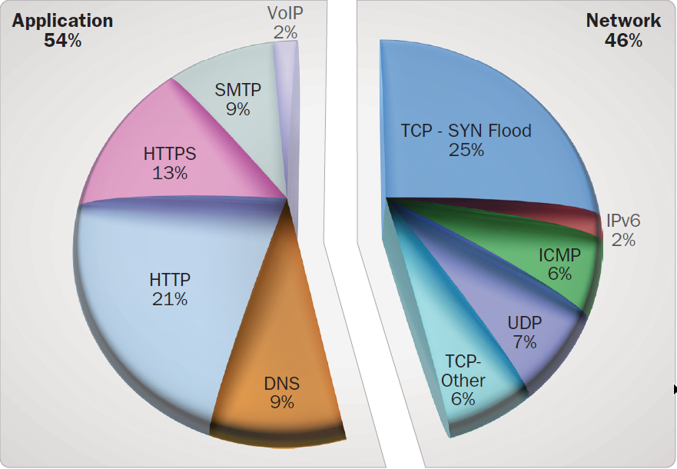
Distributed Denial-of-Service (DDoS)
Attacks classifications and examples
Classifications:
L3/L7
Direct/Indirect
Flooding/Vulnerability
Examples:
AWS DDoS Attack in 2020 (2.3 Tbps)
Lieferando.de DDoS attack in 2020

Slide 8
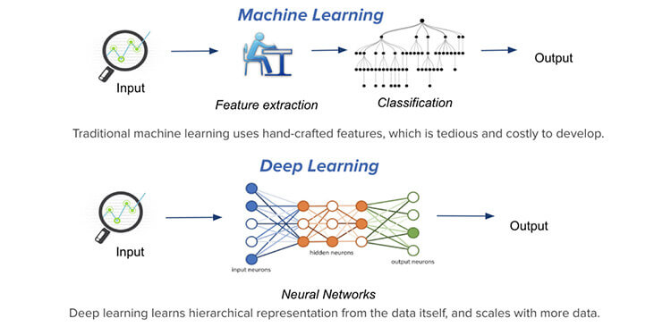
Deep learning vs Machine learning
Why?
Data :
Type
Size
Complexity
Notes:
Handcrafted features:Color&Edge::: Manually add weights
Banana/Apple Cat/Dog

Slide 9

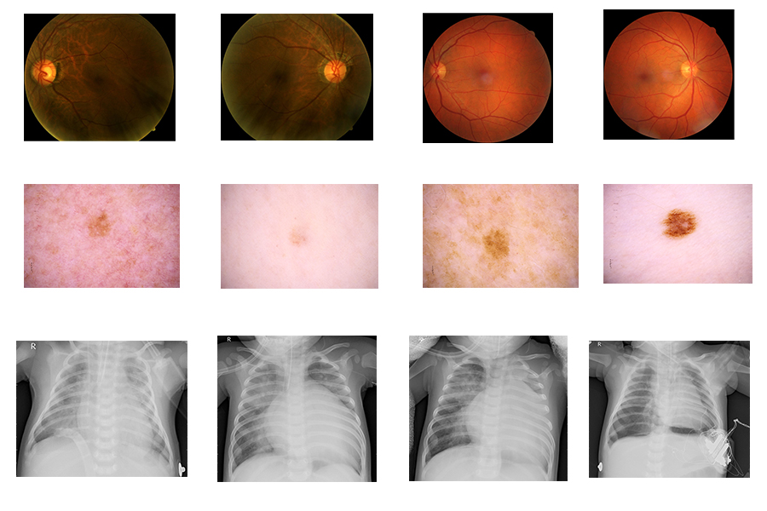
Convolutional Neural Networks (CNN)
Why?
Features:
Parameter sharing
Local connectivity
Advantages:
High performance with image datasets
Pre-trained models (ResNet, VGG, ...)
Disadvantges:
labeled data is needed
Applications:
Diabetic Retinopathy (retina disease)
MELANOMA (skin cancer)
PNEUMONIA (lung inflammation)
Notes:
Conv Process: extract capturing the features (edges, color)
each neuron is connected only to a small chunk of the input image and all the neurons in a particular feature map have the same connection weights

Slide 10
Problem Statement
DDoS attacks can affect the SDN controller availability.
Statistical methods are not enough.
Smart modern methods are needed.
Notes:
Entropy

Slide 11
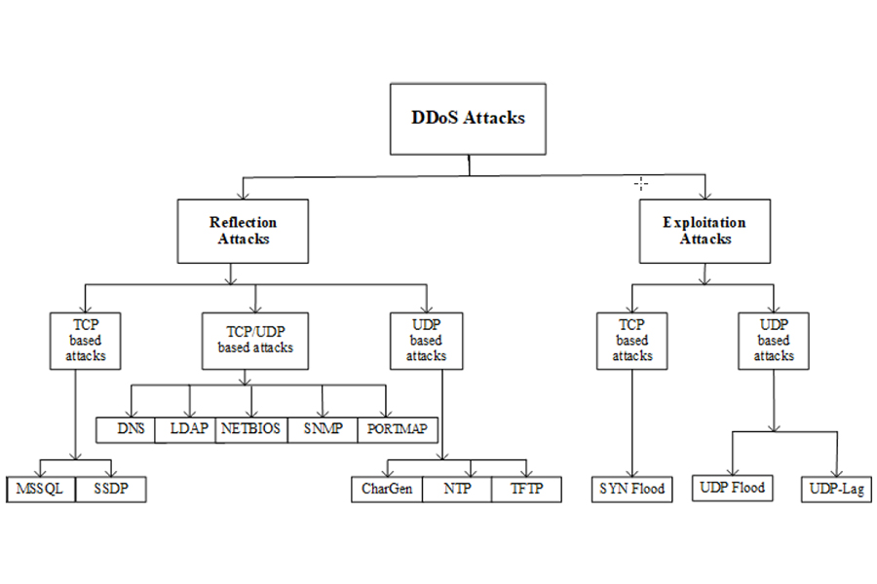
CICDDOS2019 DataSet
Attacks classifications and examples
Comparison:
NDSec-1 on AWS
CICIDS2017
CSE-CIC-IDS2018 on AWS
CICDDOS2019:
Two days traffic (train and test)
Exploitation-based and Reflection-based
>80 network traffic features
Notes:
Images (MNIST, ImageNet, MalImg)
Video (TV human interactions, ..)
Text (Urban Dictionary, ...)

Slide 12
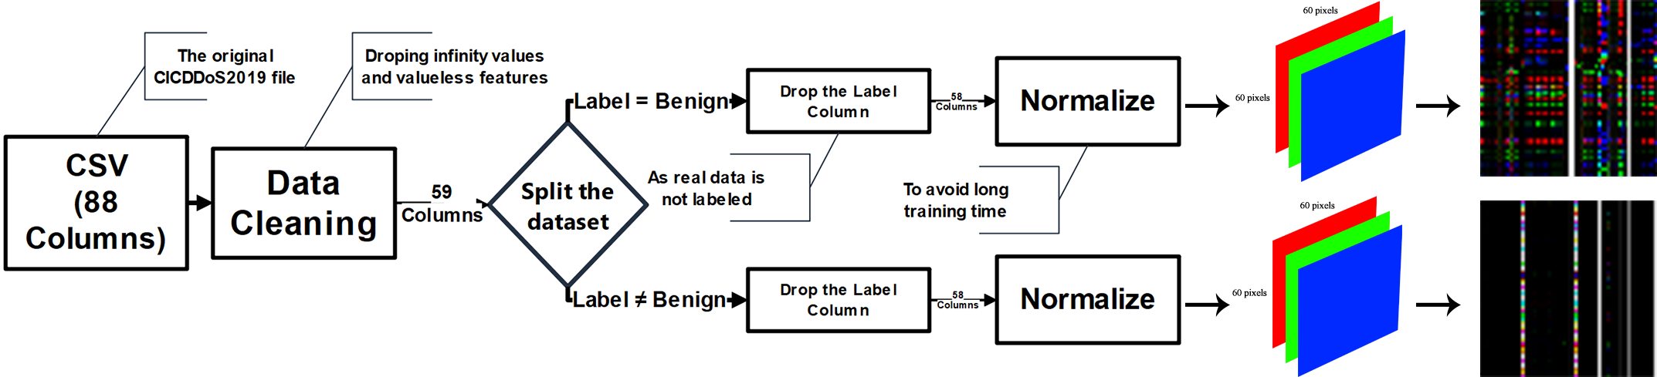
CICDDOS2019 preprocessing

Slide 13
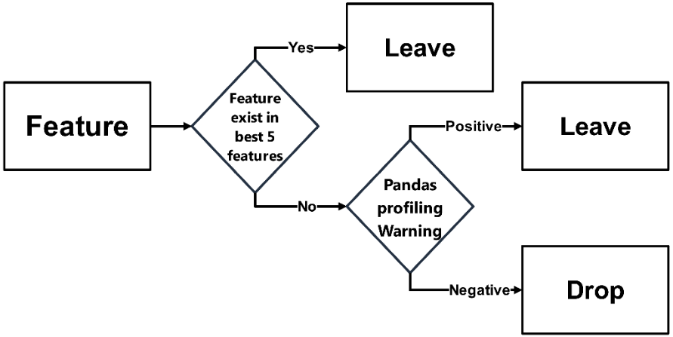
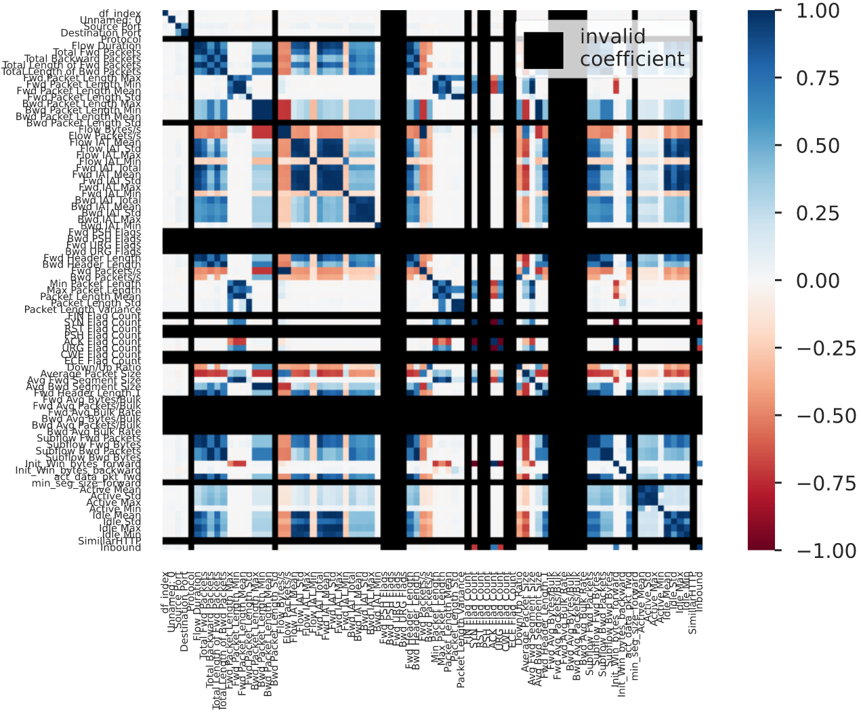
CICDDOS2019 preprocessing

Slide 14
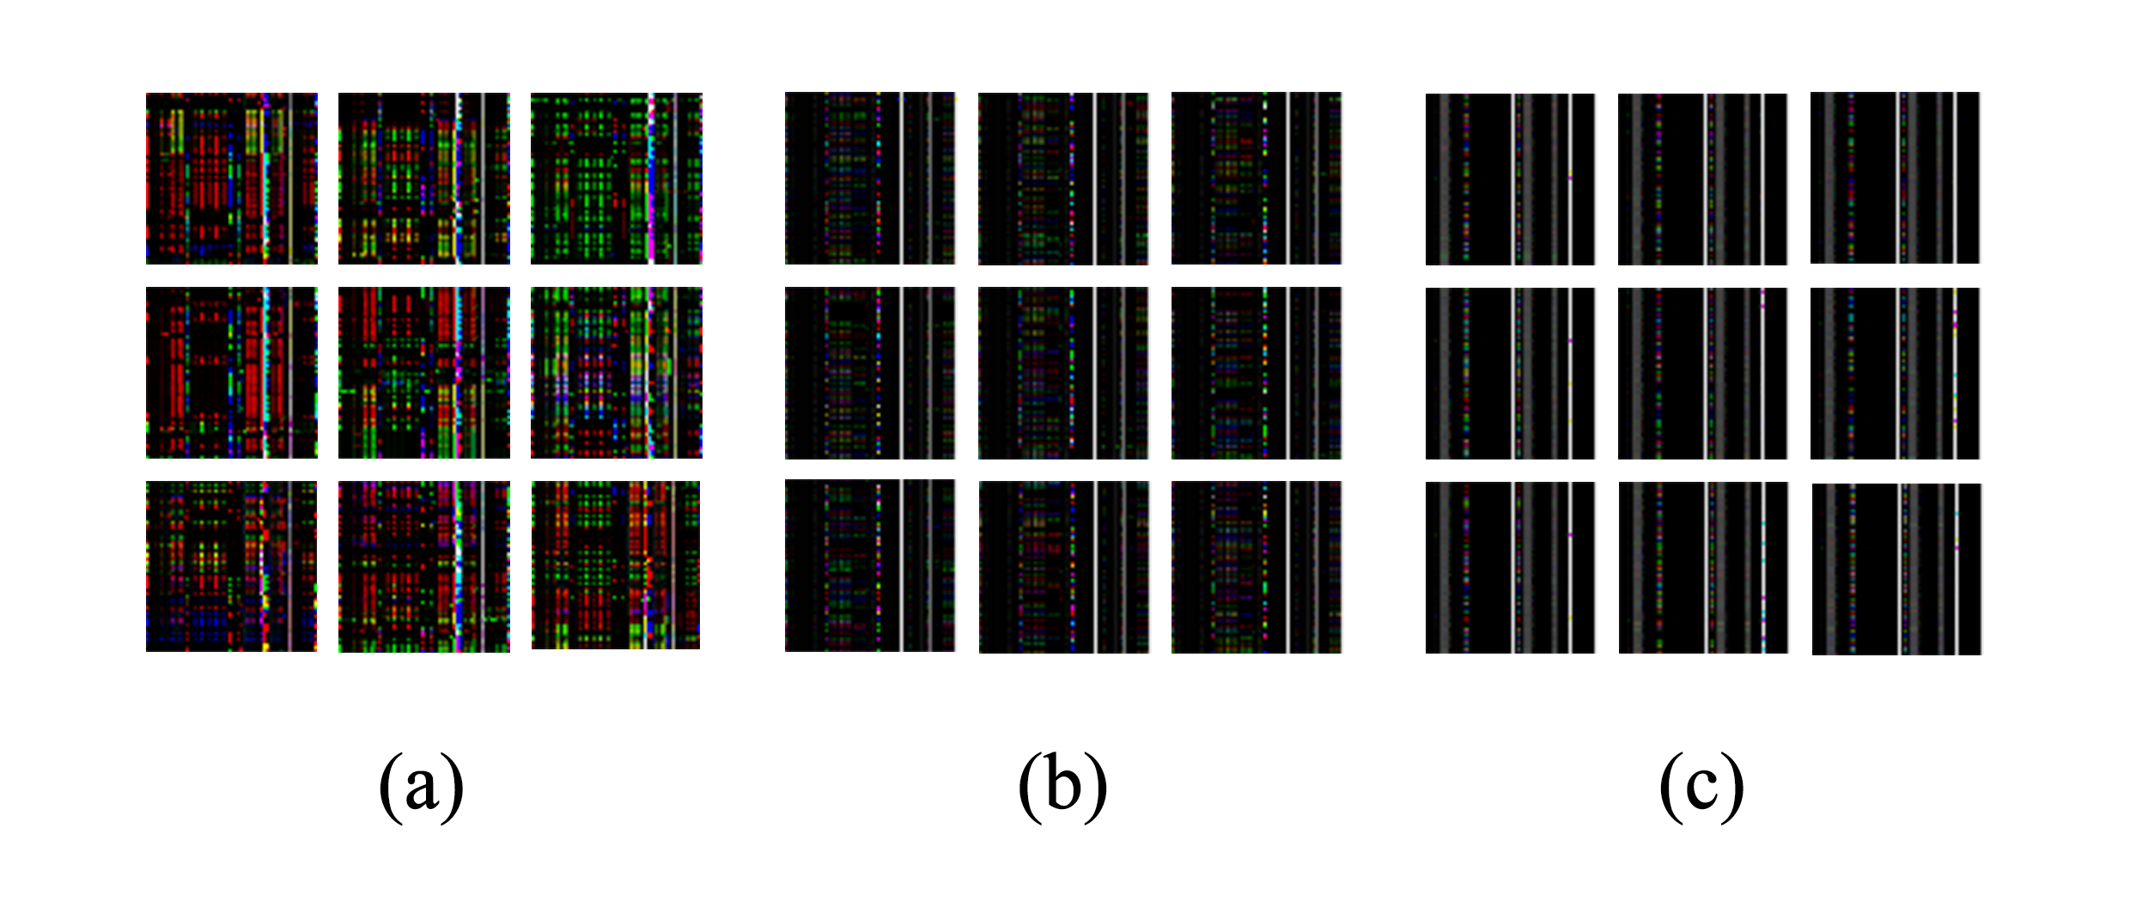
CICDDOS2019 into Images
OpenCV:
Real-time computer vision
Cross platform
Open-source

Slide 15

VGG16
Pre-trained Model
Transfer learning
ImageNet
16 Layers
Kernel/Filter Size
Padding
No. of layers
Number of nureons
Learning rate
optimizer

Slide 16
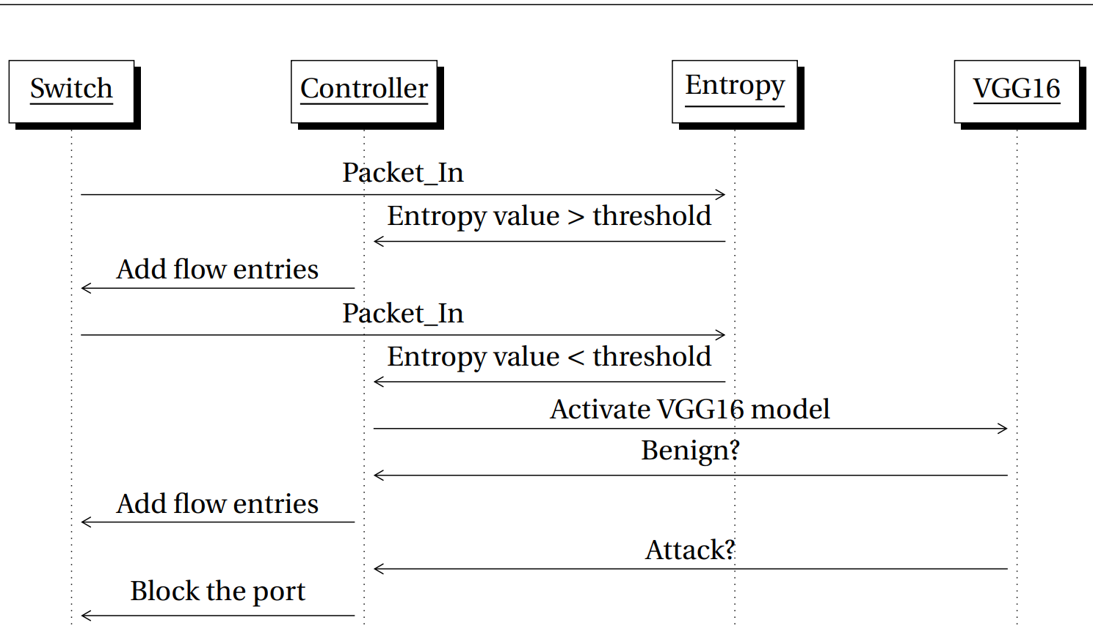
Algorithm Design
Packet_out
Packet_out
OFPT_FLOW_MOD
OFPT_PORT_MOD

Slide 17
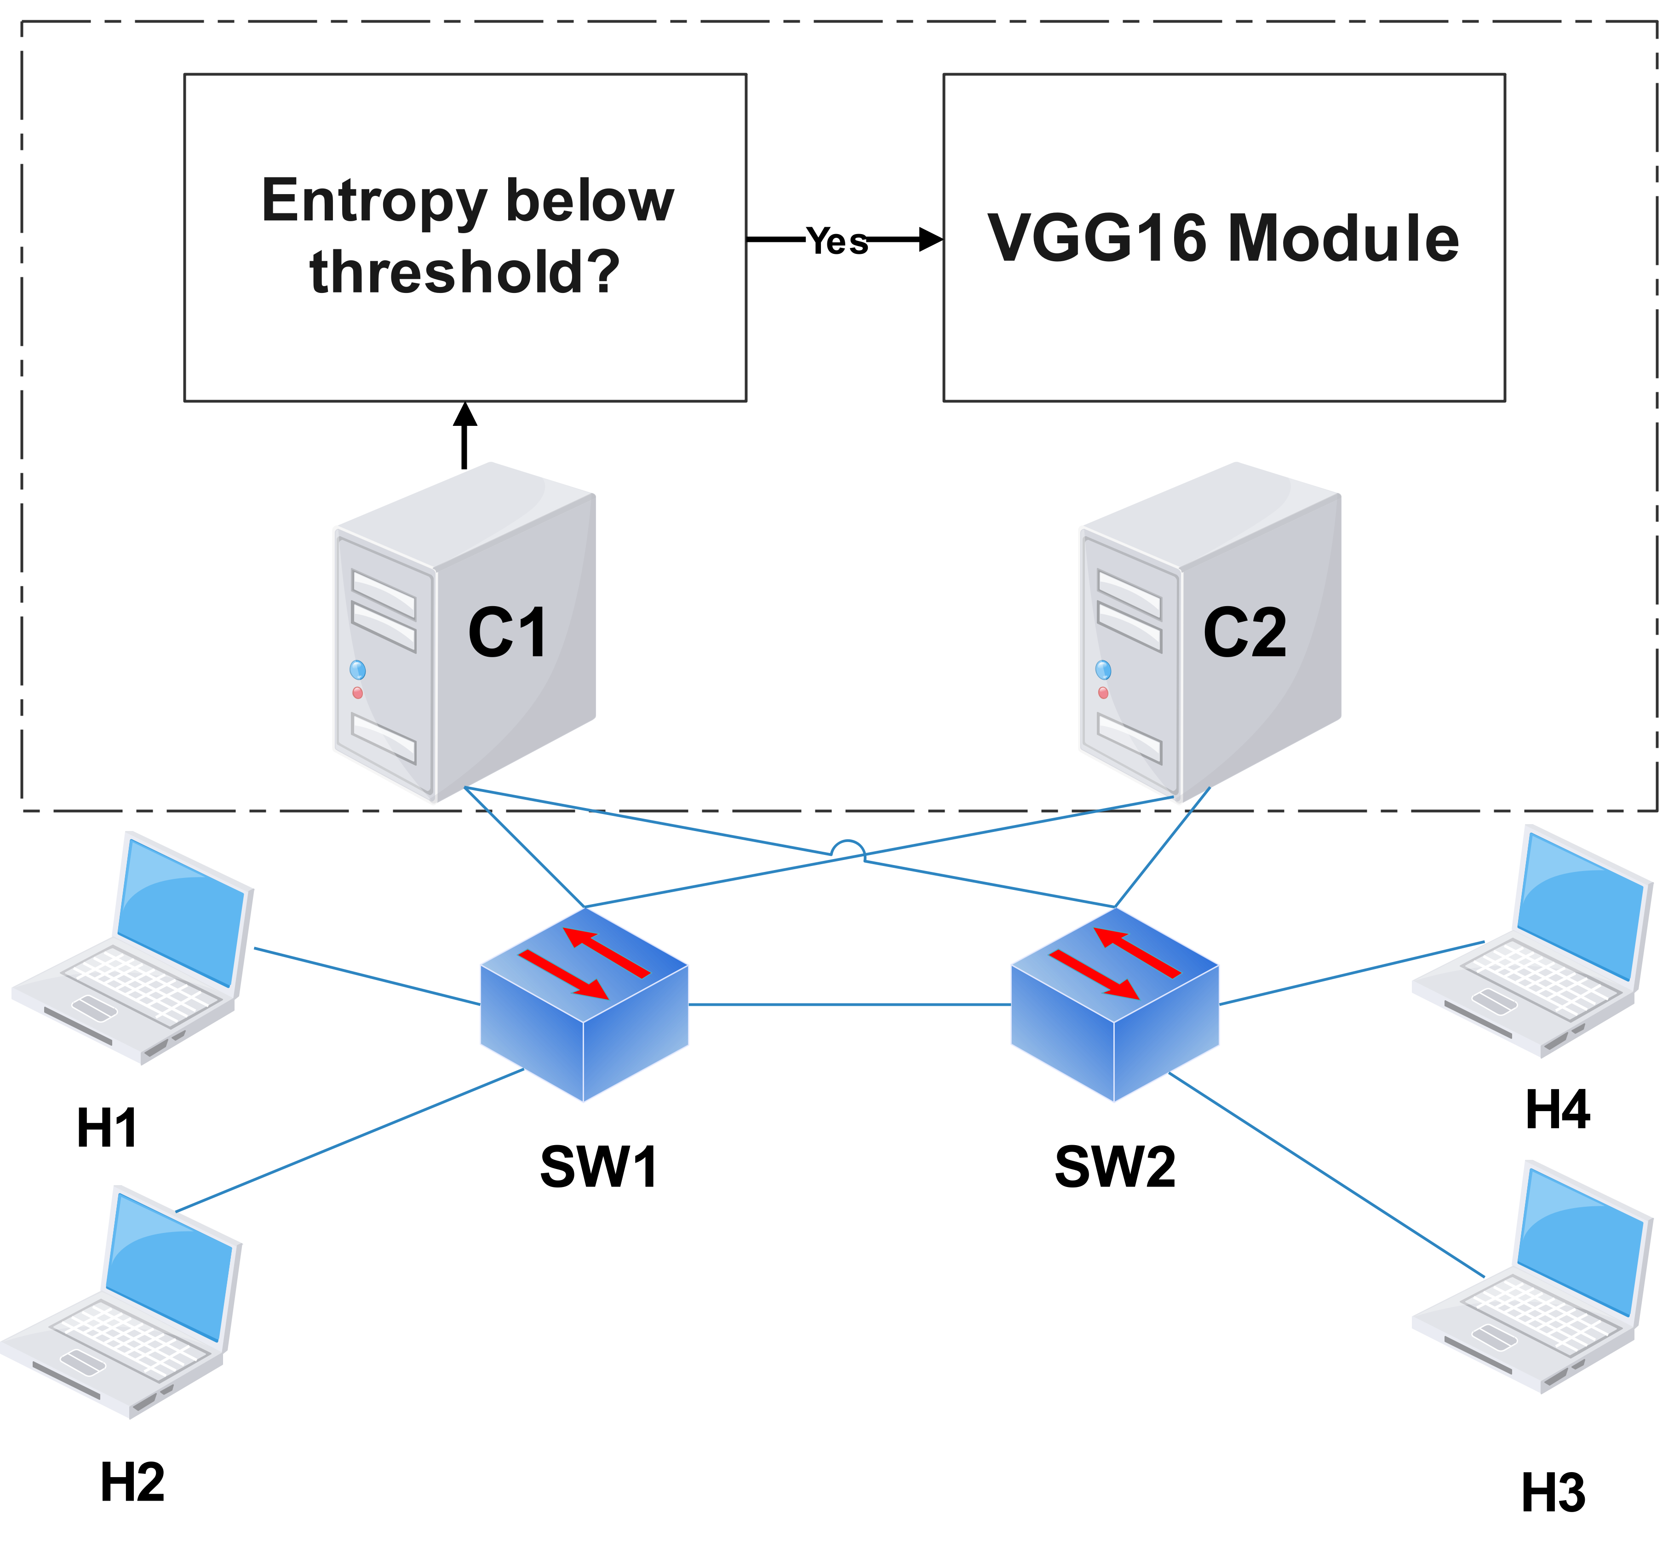
System Design
Equal-role controllers
2 switches
4 hosts
TCPReplay
Notes:
Entropy here is a tunable value and varies based on the image size.

Slide 18
Problems and solutions
Overfitting. Dropping valueless features.
Imbalanced data. Use CICflowmeter.
Invalid rows. Dropping Infinity values.
Controller overload Entropy module.
CNN parameters Use VGG16.
Notes:
unequal distribution of classes in the training dataset
Go by the book concept:........low bias and high variance

Slide 19
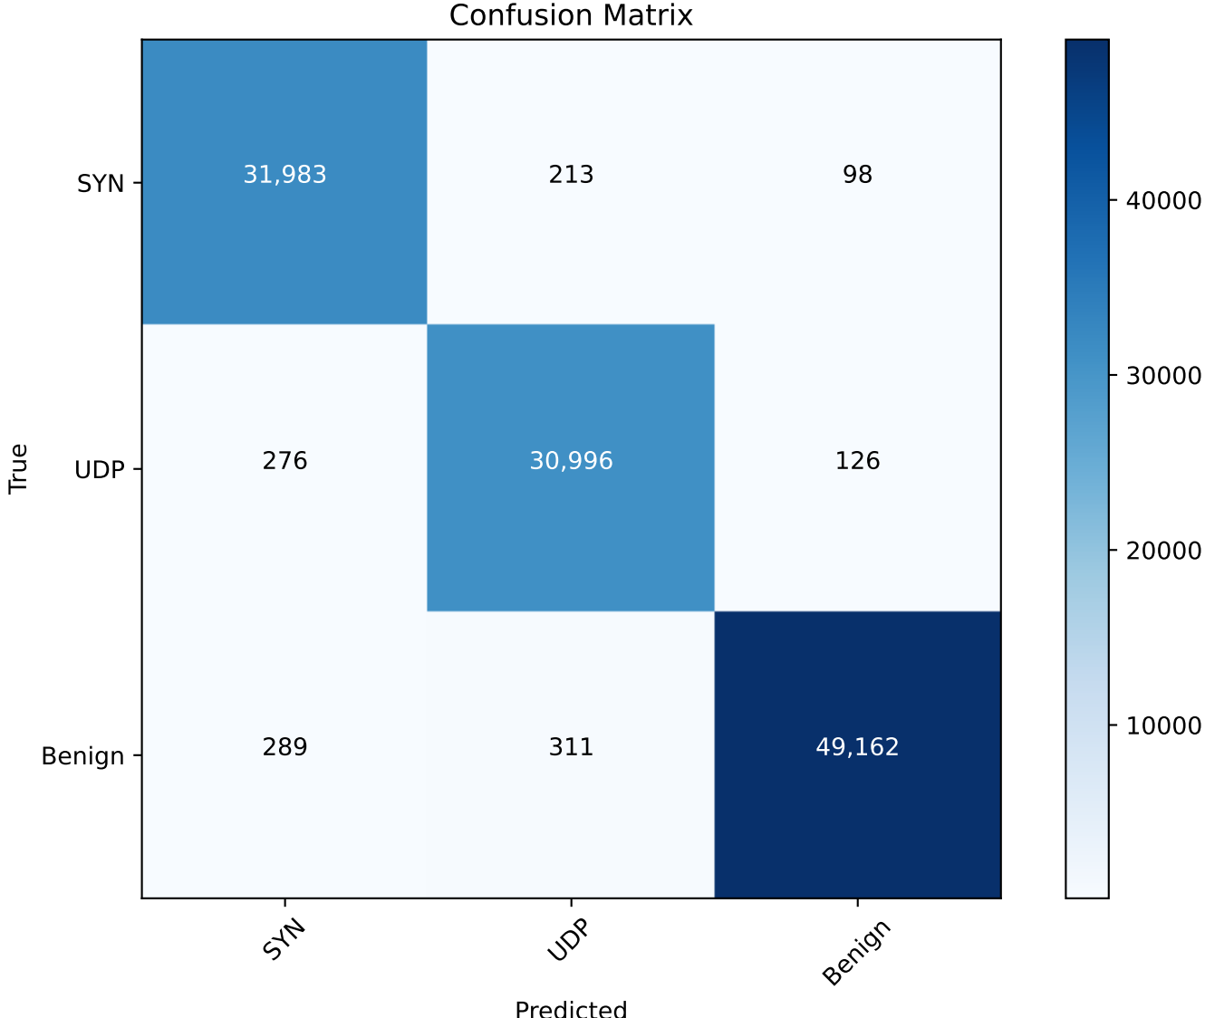
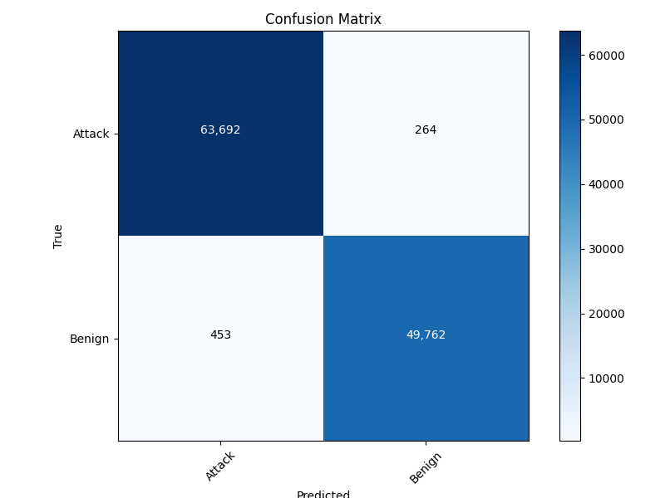
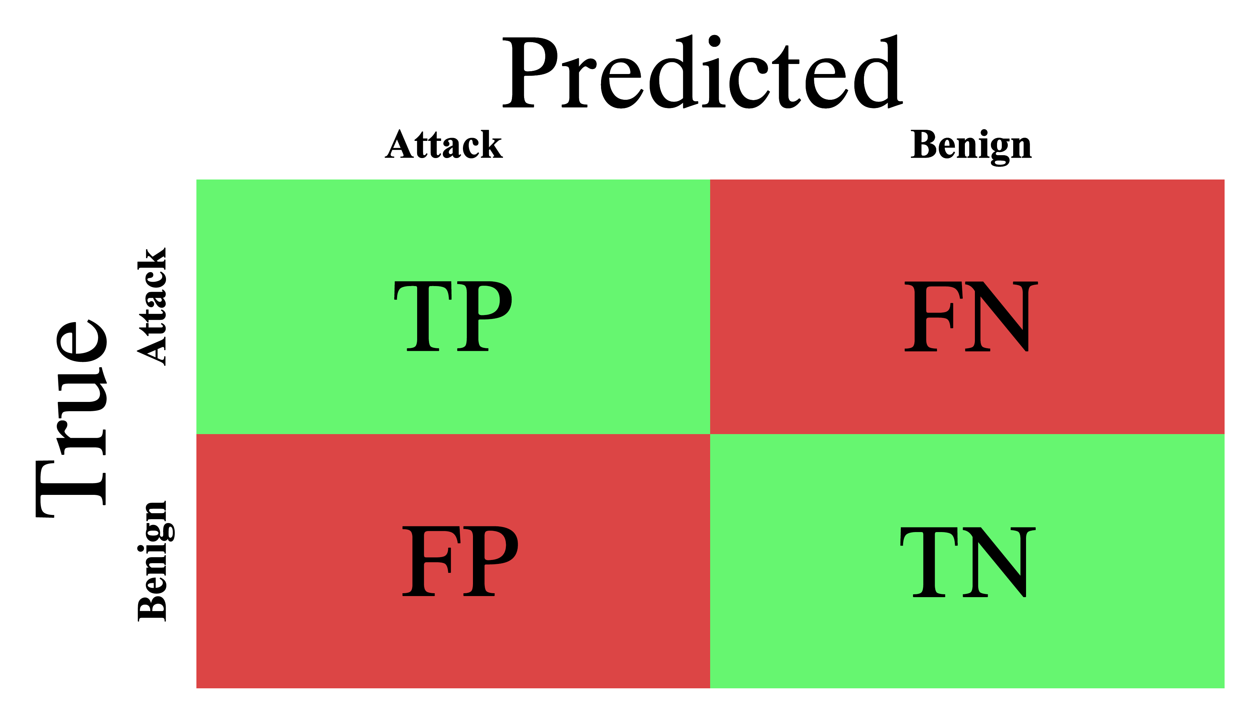
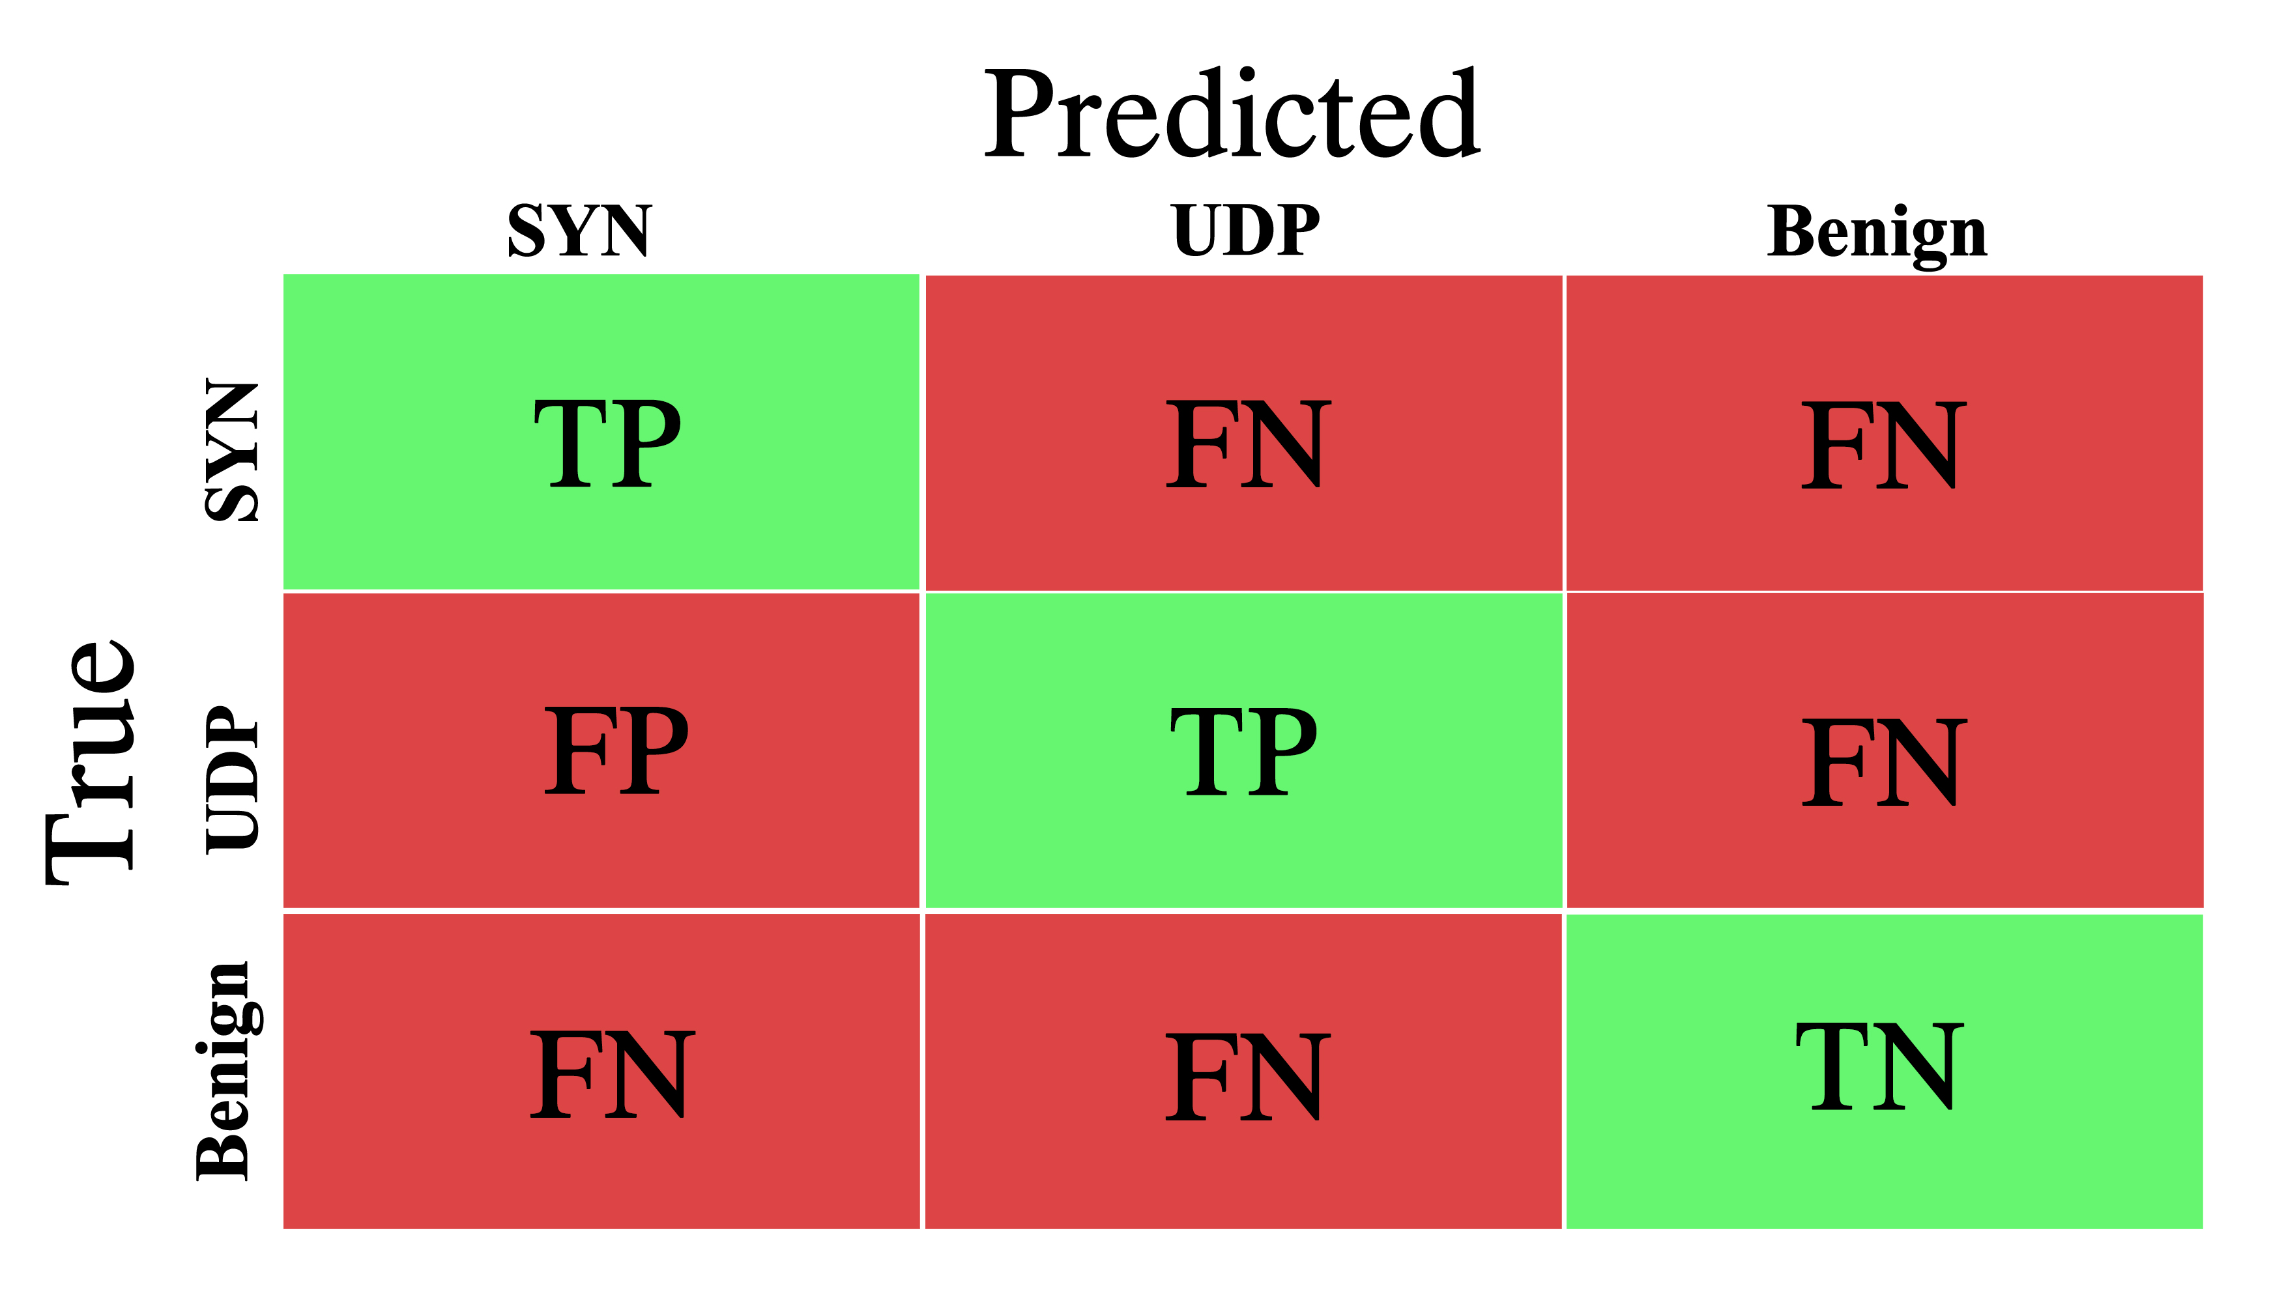
Results
Notes:
Binary classification (sigmoid) vs Categorical classification (softmax)

Slide 20
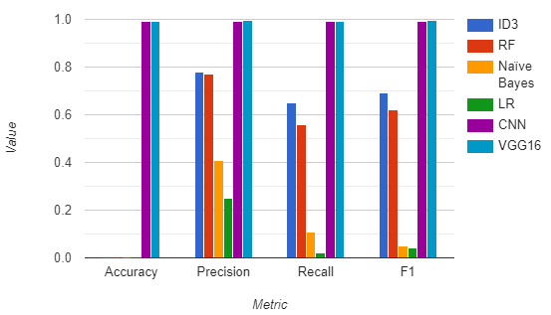
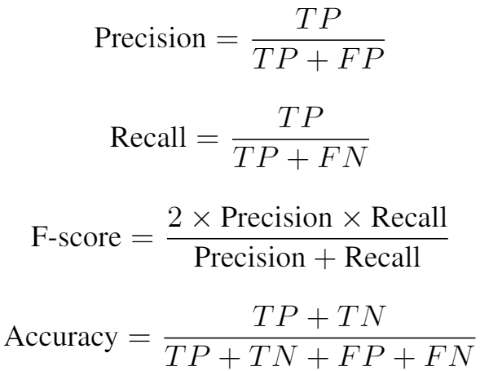
Results
Notes:
Precision: This measures how well our algorithm identifies only anomalies.
Recall: This measures how well we identify all anomalies.

Slide 21
Conclusion and Future Work
Deep learning approaches show great results in DDoS attacks detection.
VGG16 model outperforms CNN-based state-of-the-art model.
It is depicted by simulation results that the attacker can be identified and blocked.
Using other pre-trained models, for example, VGG19, AlexNet, and ResNet50.
Combine two or more deep learning approaches.
Investigate the possibility to detect simultaneous DDoS attacks.

Slide 22
References
- https://www.merkleinc.com/blog/dispelling-myths-deep-learning-vs-machine-learning
- A. Pradhan and R. Mathew, “Solutions to vulnerabilities and threats in software defined networking (SDN),” Procedia Computer Science, vol. 171, pp. 2581–2589, 2020. [Online]. Available: https://doi.org/10.1016/j.procs.2020.04.280
- N. Katta, O. Alipourfard, J. Rexford, and D. Walker, “Infinite CacheFlow in softwaredefined networks.” ACM, Aug. 2014. [Online]. - I. E. F. Tulio A. Pascoal, Yuri G. Dantas and V. Nigam, “Slow tcam exhaustion ddos attack,” May 2017. [Online].
-Y. Zhou, K. Chen, J. Zhang, J. Leng, and Y. Tang, “Exploiting the vulnerability of flow table overflow in software-defined network: Attack model, evaluation, and defense,” Security and Communication Networks, vol. 2018, pp. 1–15, 2018. [Online].
- S. Ali, M. K. - Alvi, S. Faizullah, M. A. Khan, A. Alshanqiti, and I. Khan, “Detecting ddos attack on sdn due to vulnerabilities in openflow,” in 2019 International Conference on Advances in the Emerging Computing Technologies (AECT), 2020 .
- G. Pujolle, in Software Networks : Virtualization, SDN, 5G, and Security, vol. 1, 2020.
- D. P. A. Brij B. Gupta, Gregorio Martinez Perez and D. Gupta, in Handbook of Computer Networks and Cyber Security, 2020.

Slide 23
Thank You

Slide 24
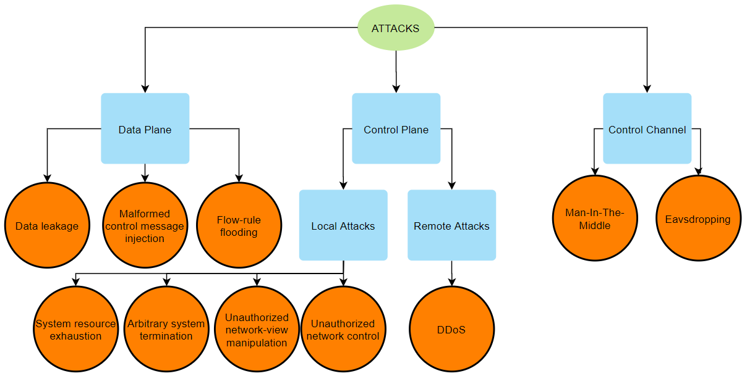

Slide 25
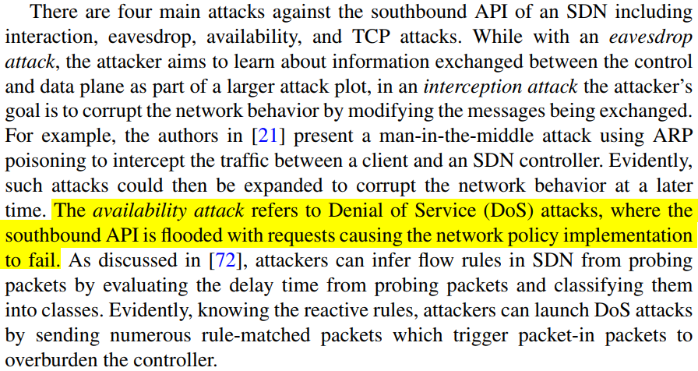
D. P. A. Brij B. Gupta, Gregorio Martinez Perez and D. Gupta, in Handbook of Computer Networks and Cyber Security, 2020.

Slide 26
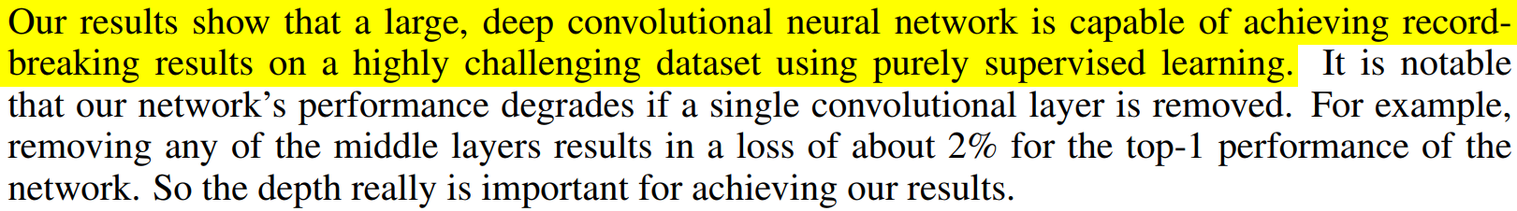
Krizhevsky A, Sutskever I, Hinton GE (2012) Imagenet classification with deep convolutional neural networks.

Slide 27
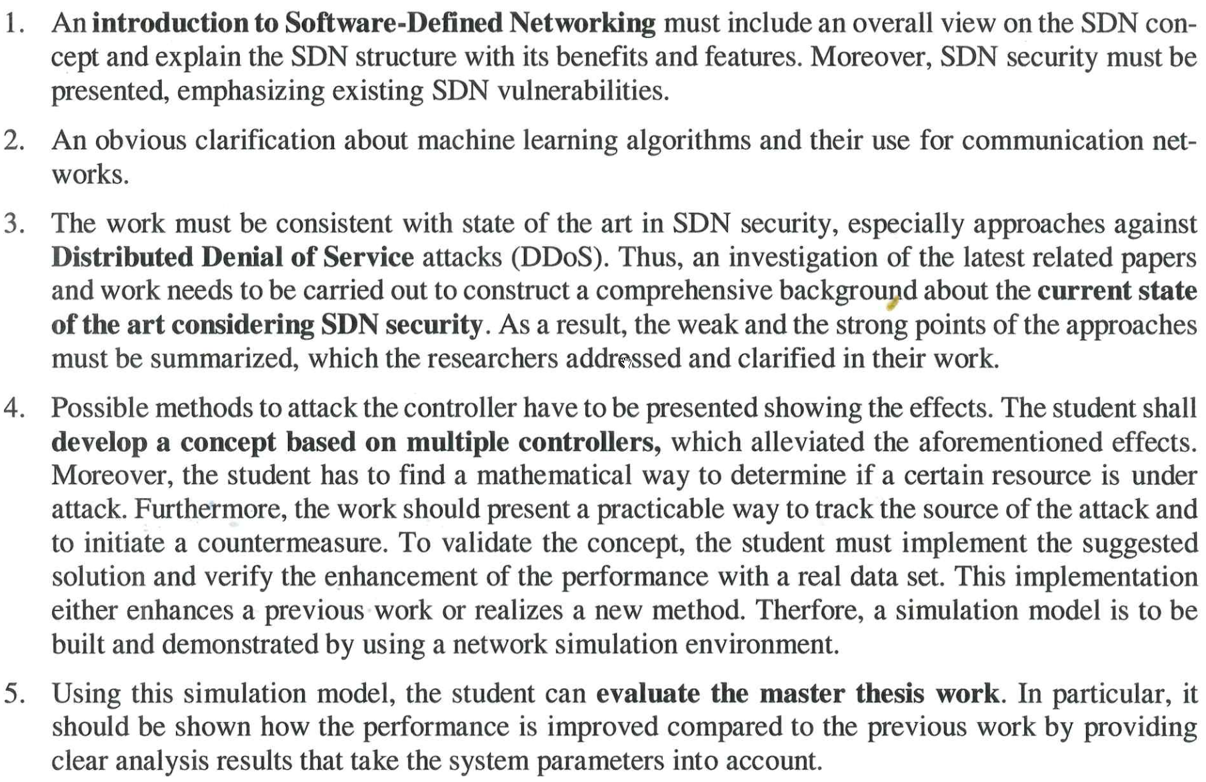

Slide 28
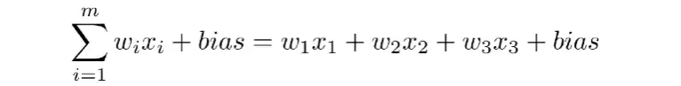

Slide 29
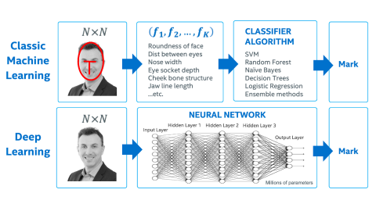

Slide 30
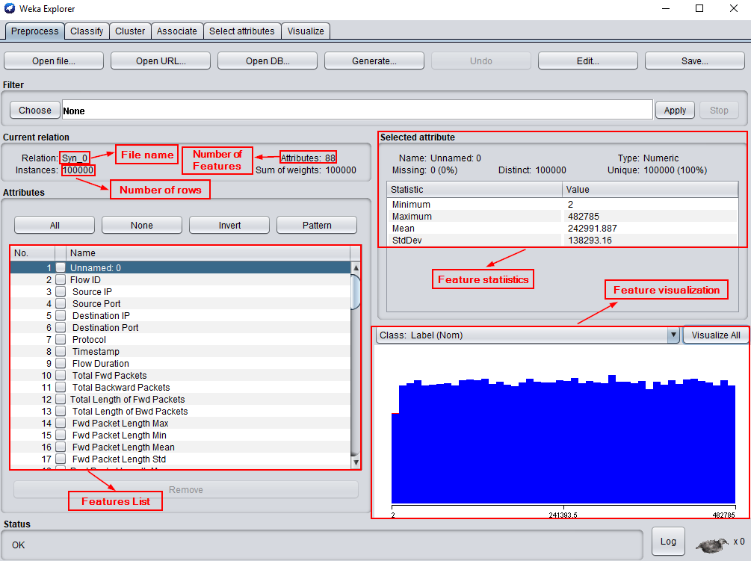

Slide 31
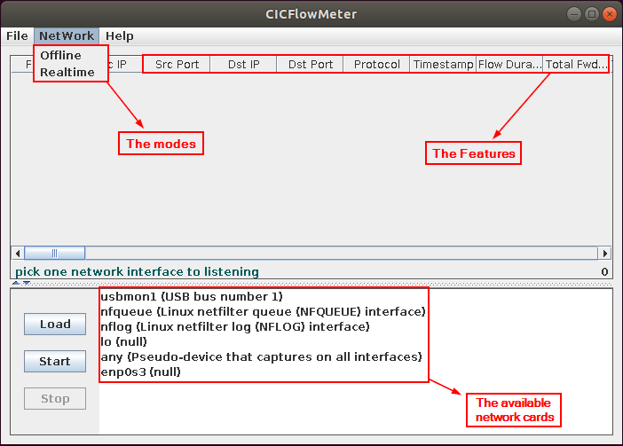

Slide 32
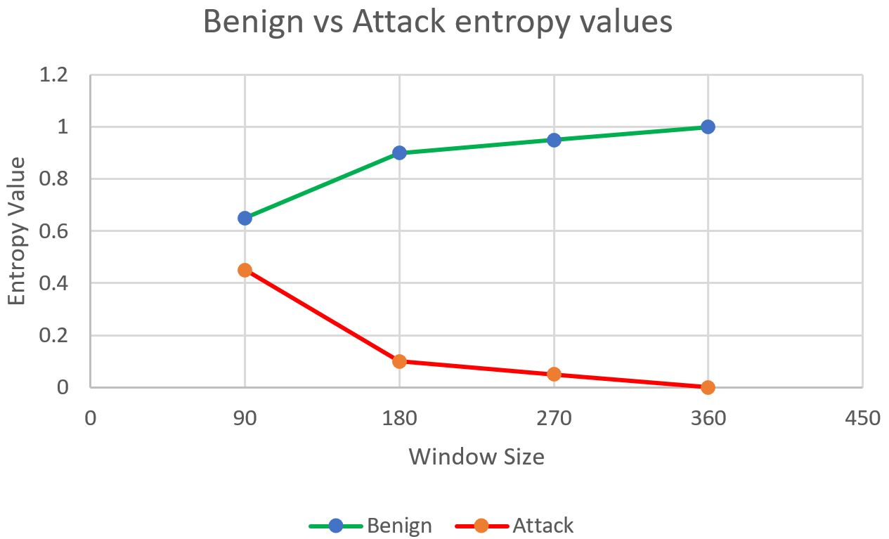

Slide 34
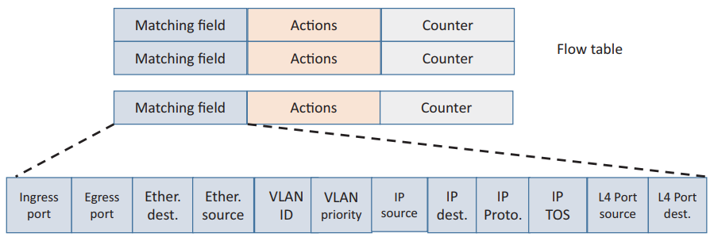

Slide 35
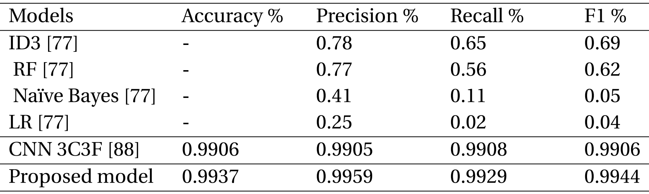

Slide 36


Slide 37
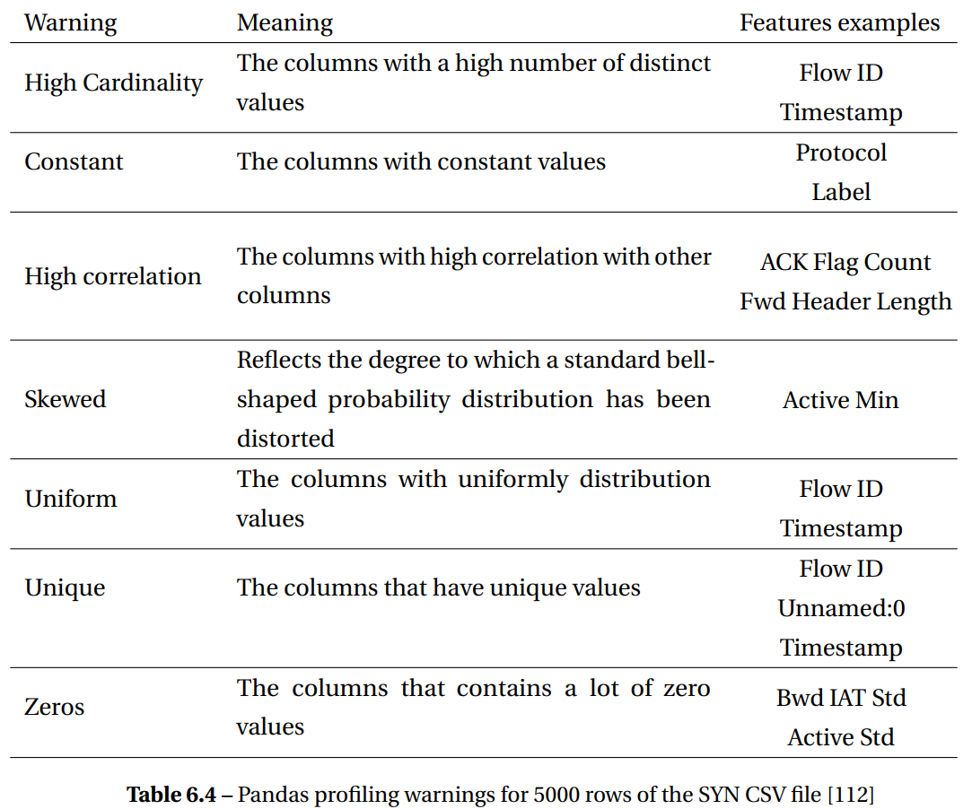

Slide 38
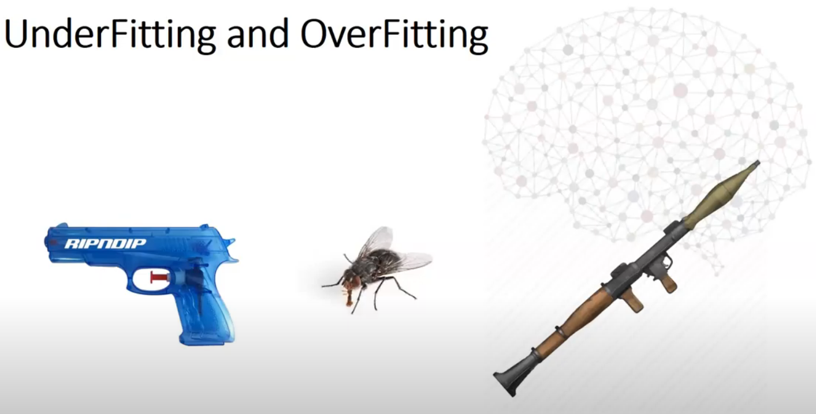

Slide 39
